Slide 1

Insurance for Diabetes Patient Prediction
Foundation of Data Analytics Review - 2
Group: F2A3

Slide 2
Members
Mentor: Dr. Trilok Nath Pandey
Abhishek NN - 20BCE1025
Fidal Mathew - 20BCE1430
Ayush Kapri - 20BCE1458
Mayank Gupta - 20BCE1538

Slide 3
INTRODUCTION
According to a report by the International Diabetes Federation in 2022, there were 425 million diabetics in the world at the time, and it was also concluded that the number will increase to 625 million by 2045.
The disease is characterized by a chronic course, as well as a violation of all types of metabolism. Generally, diabetes is mainly classified into two categories: type 1 diabetes, type 2 diabetes.
The former is caused by the destruction of the pancreatic beta cells, resulting in insulin deficiency, while the latter is due to the ineffective transportation of insulin into cells.
With the development of technology in the medical sector, it is now possible to anticipate the onset of a Diabetes by utilizing ML techniques.

Slide 4
Problem Statement
Today, diabetes is one of the most common, chronic, and, due to some complications, deadliest diseases in the world. The early detection of diabetes is very important for its timely treatment since it can stop the progression of the disease.
The proposed method can help not only to predict the occurrence of diabetes in the future and to determine the type of the disease that a person experiences but also suggest the insurance policy amount. Considering that type 1 diabetes and type 2 diabetes have many differences in their treatment methods, this method will help to provide the right treatment for the patient.
By transforming the task into a classification problem, our model is mainly built using the machine learning algorithms (Logistic Regression, Naïve Bayes, Random Forest, Decision Tree, Kernel SVM). According to World Health Organization (WHO), Diabetes is the 2nd leading cause of death globally, responsible for approximately 11% of total deaths.
As we had discussed in our project, we will be analyzing datasets using predictive analysis and machine learning models.

Slide 5
HOW CAN IT BE PREDICTED ?
Machine learning is the answer
Using the Puma Indiana Diabetes dataset from Kaggle, me and my fellow team were able to use machine learning to get a 79.77% accuracy in Classifying the severity of Diabetes. The factors taken into consideration from the datasets were age, gender: biological male & female, having pre-existing hypertension, pre-existing heart disease, marriage status, work type, residence: urban or rural, glucose level, BMI, and smoking status.

Slide 6
Literature Review
Themes Discovered:
Most frequently used algorithms -
Publications:
https://www.analyticsvidhya.com/blog/2022/01/diabetes-prediction-using-machine-learning/
Author: Aman Preet Gulati
Observation:
Highest Precision – Logistic Regression (77.7%)
Logistic Regression, Naïve Bayes, Random Forest, Decision Tree, Kernel SVM

Slide 7
Current trends and gaps in them:
After using all these patient records, we are able to build a machine learning model (Logistic Regression – best one) to accurately predict whether or not the patients in the dataset have diabetes or not along with that we were able to draw some insights from the data via data analysis and visualization
Current scenarios have a lot of time delay, we look to be able to provide results in real time.

Slide 8
Methodology
Reading File Data to R
Data Cleaning
Building the term document matrix (Confusion matrix)
Accuracy Scores
Data Visualization
Data Modeling
Feature Selection Analysis

Slide 9
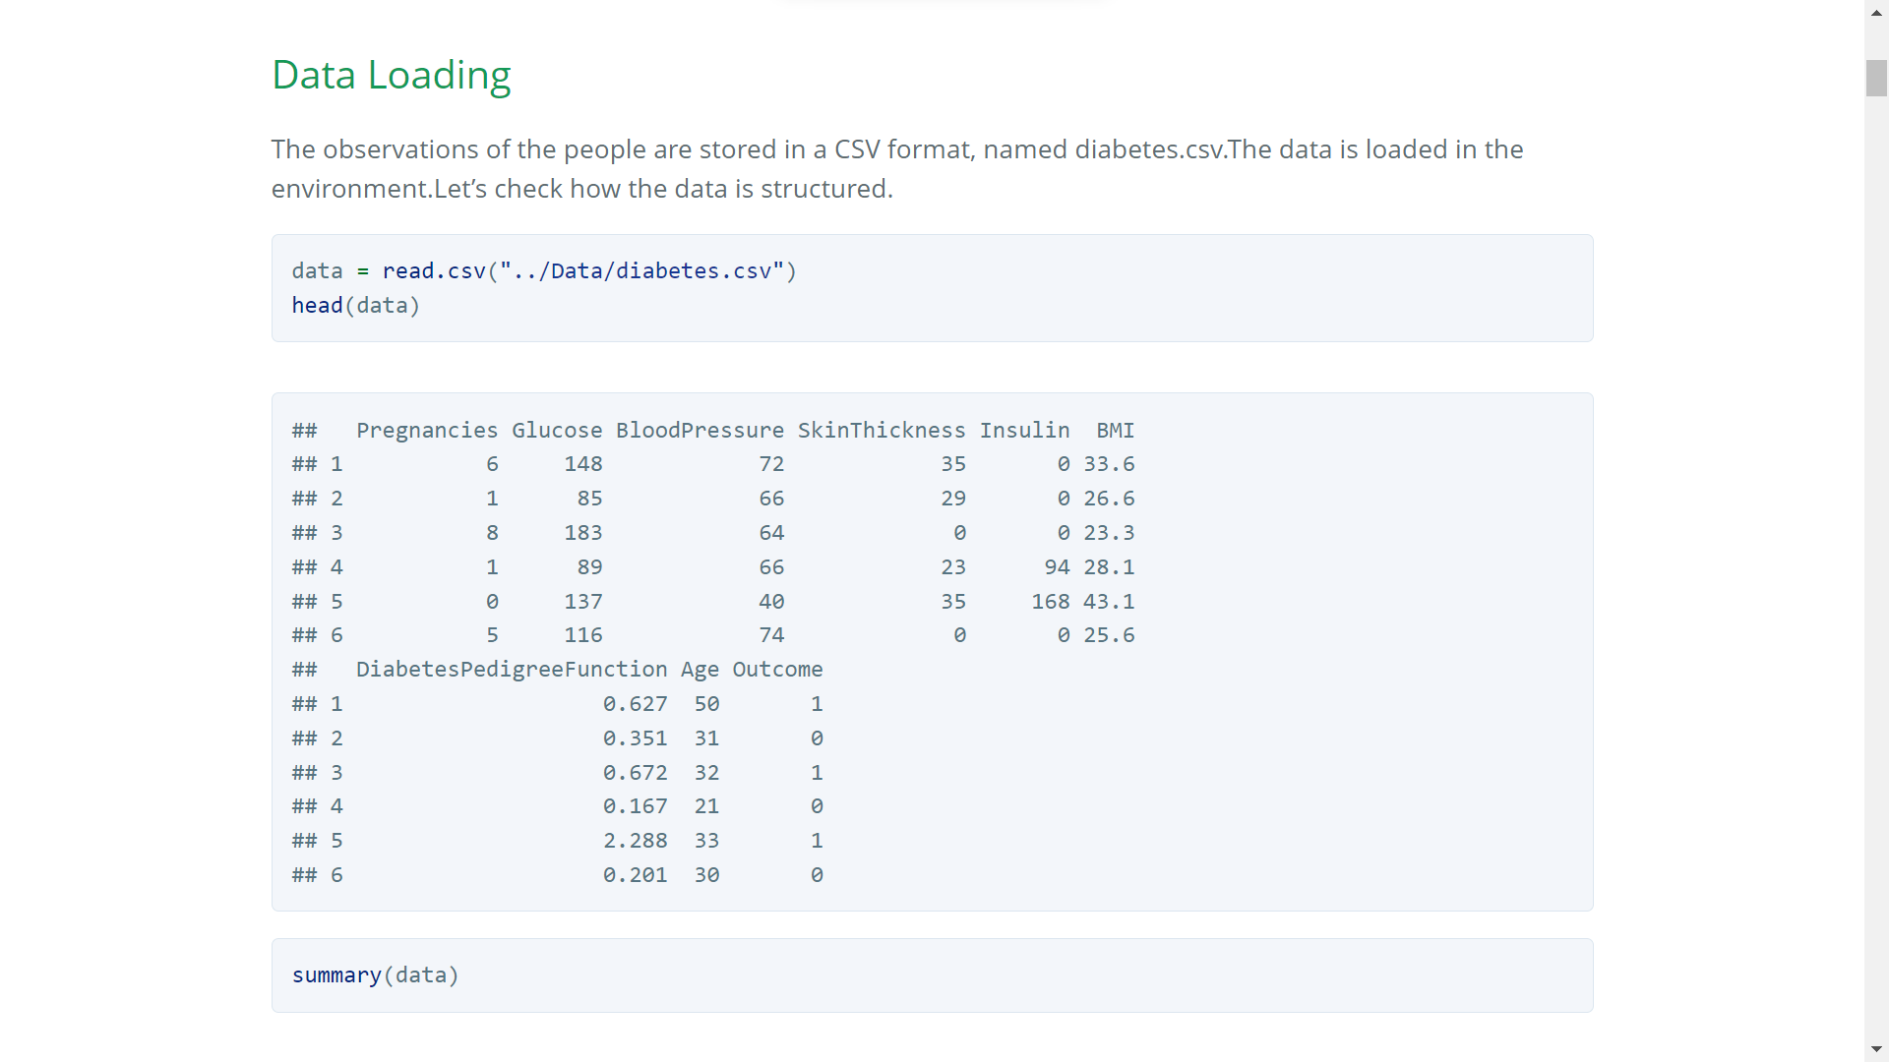
DATA READING

Slide 10
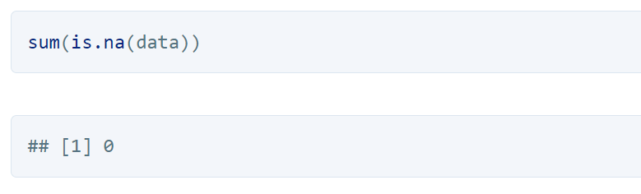
DATA CLEANING
Data cleaning is the process of fixing or removing incorrect, corrupted, incorrectly formatted, duplicate, or incomplete data within a dataset.
In R, we have used DPLYR. dplyr is a grammar of data manipulation, providing a consistent set of verbs that help you solve the most common data manipulation challenges: mutate() adds new variables that are functions of existing variables. select() picks variables based on their names.
In R, we have used median imputation for replacing the missing values and in python we have used mean imputation.

Slide 11
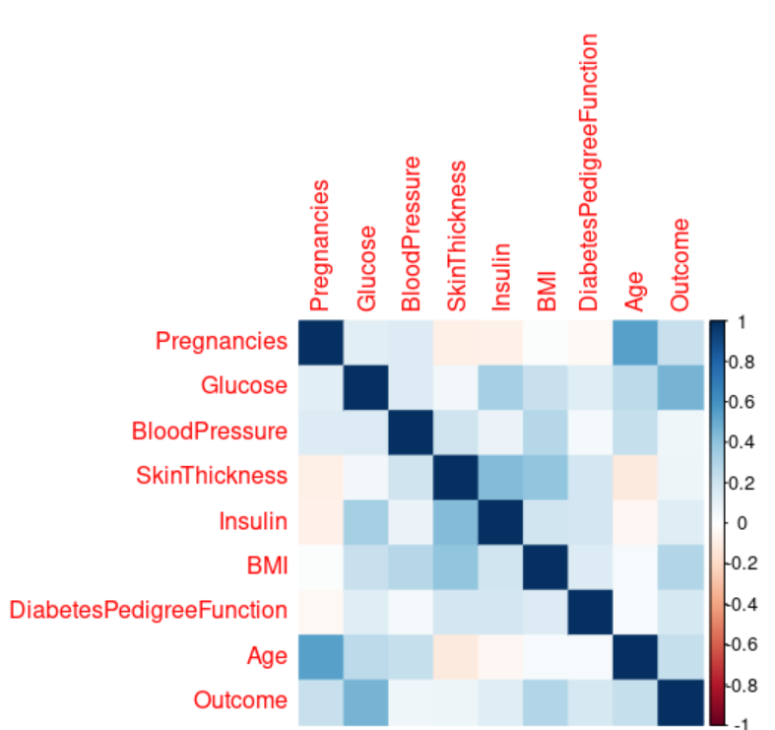
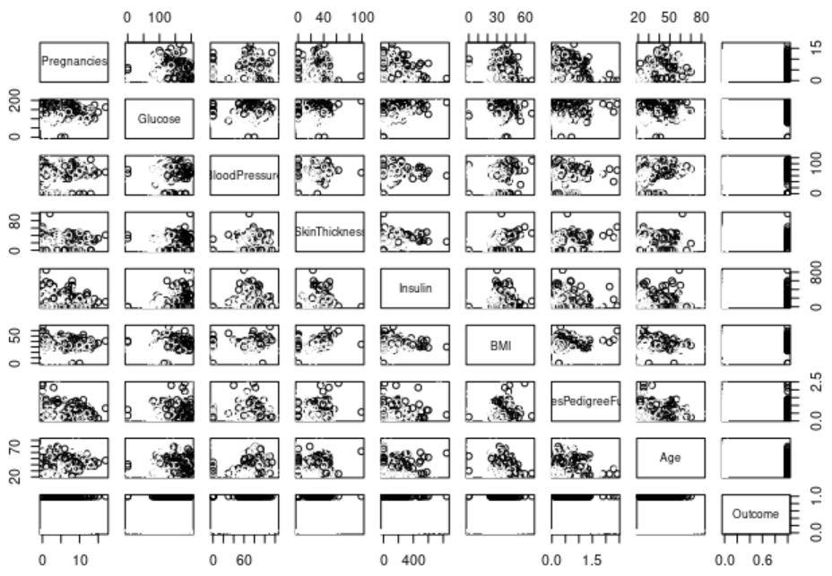
Train Test Data Split &VISUALISATION
The dataset is splitted into training and testing dataset.
In R,we have used ggplot library and basic plotting functions to visualise the dataset.
For Example: Inference : People who had heart disease have higher chances of stroke.
Visualization
Correlations

Slide 12
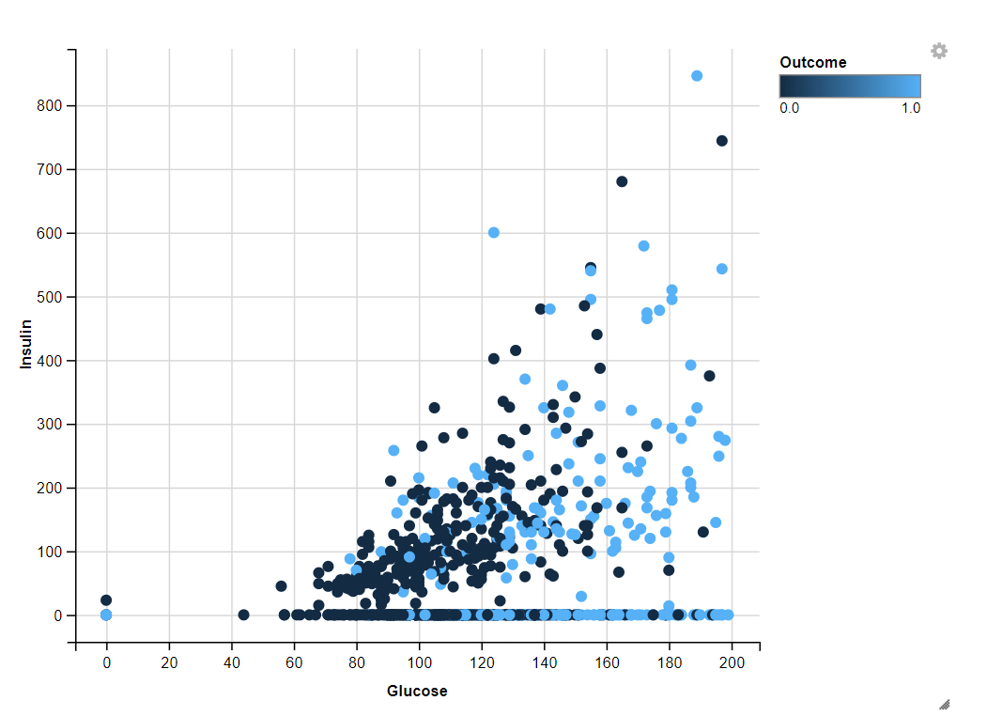
Glucose and Insulin
The glucose and the insulin are the major factors of the diabetes…which in turn have direct proportionality in the future during the diabetes. They are the major cause of the occurence. They are strong correlated on each other.
data %>% ggvis(~Glucose,~Insulin,fill =~Outcome) %>% layer_points()

Slide 13
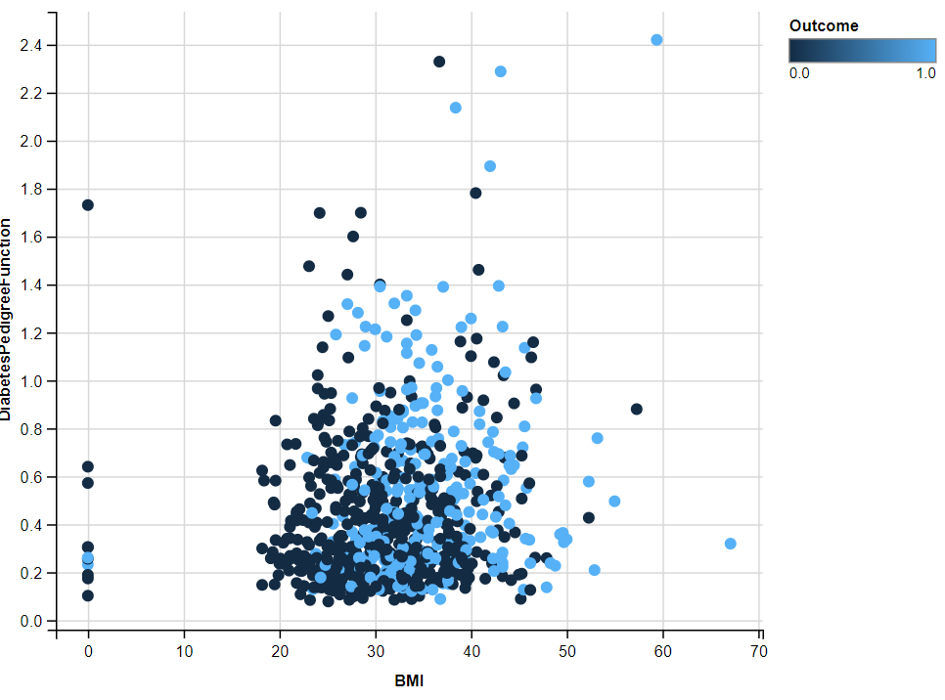
BMI ad DiabetesPedigreeFunction
The BMI and DiabetesPedigreeFunction is plotted here.
data %>% ggvis(~BMI,~DiabetesPedigreeFunction,fill =~Outcome)
%>% layer_points()

Slide 14
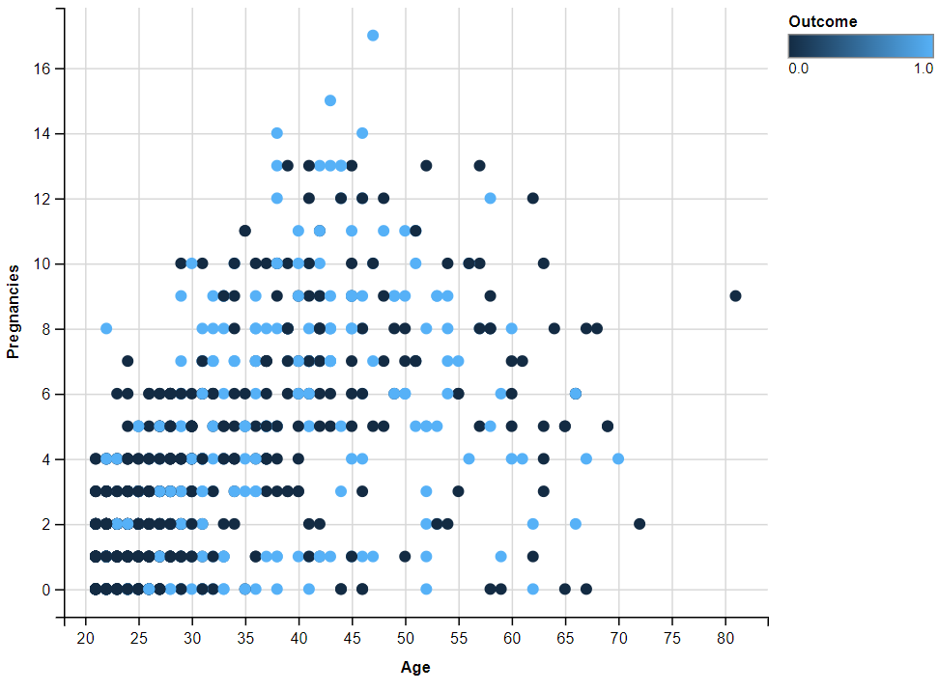
Age and Pregnancies
The males have 0 for the pregnancy attribute, which is why we find a lot of values plottinh zero in this grpah.
data %>% ggvis(~Age,~Pregnancies,fill =~Outcome) %>%
layer_points()

Slide 15
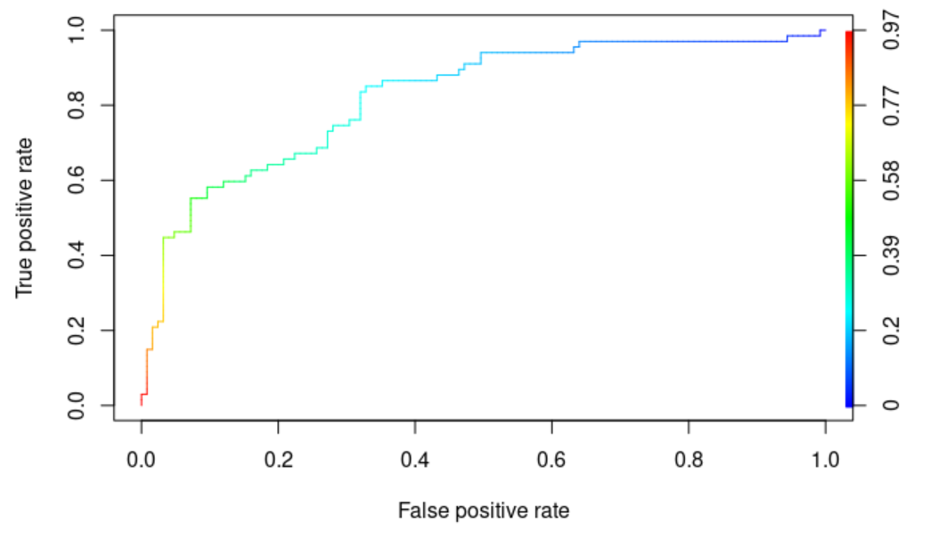
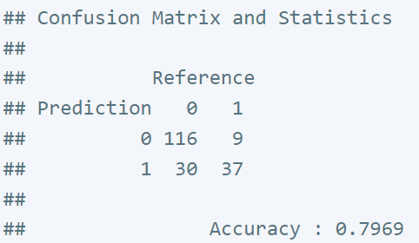
LOGISTIC REGRESSION (0.79)
The Logistic regression helps to classify the concern person will get diabetes or not.Since we are using the logistic regression we have to mention that, family = binomial.We are using all the attributes we have in the dataset.Let us take a look at the summary.
model <- glm (Outcome ~ .-Pregnancies + Glucose + BloodPressure + SkinThickness + Insulin
+ BMI + DiabetesPedigreeFunction + Age, data = data_train, family = binomial)
summary(model)

Slide 16
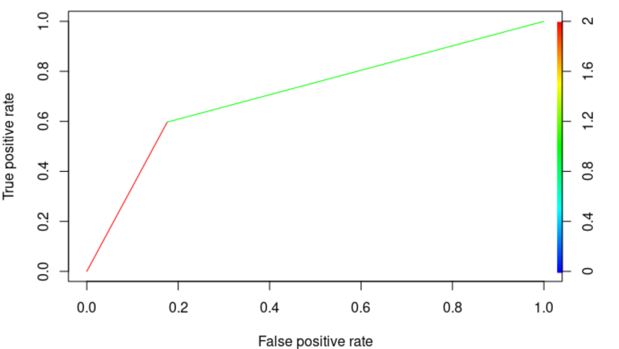
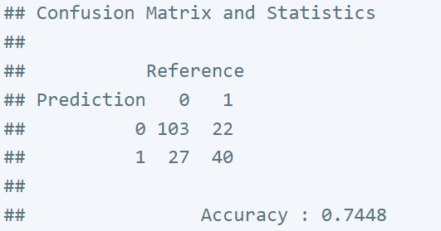
DECISION TREE (0.74)
library(rpart)
model4 = rpart(formula = Outcome ~ .,data = data_train) model4

Slide 17
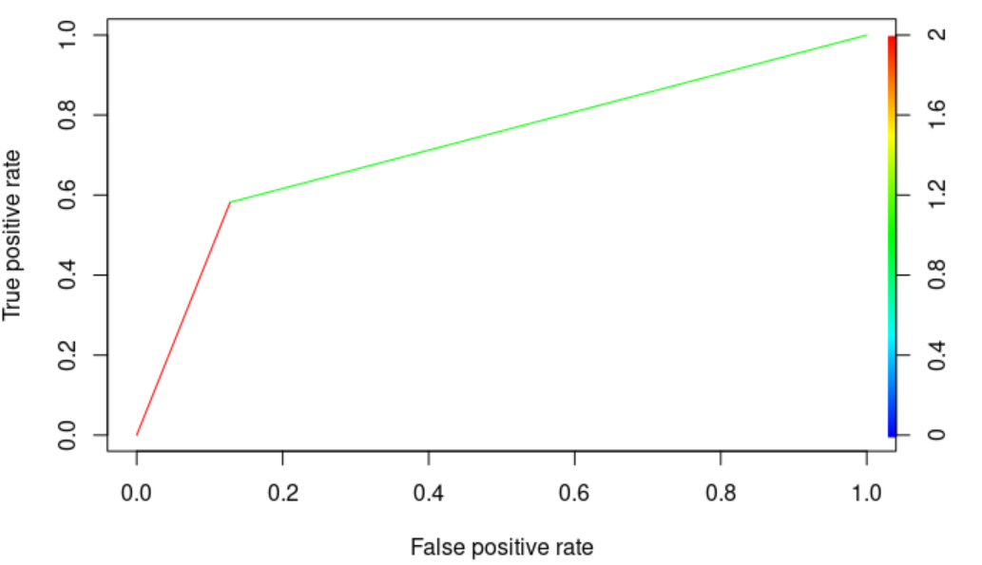
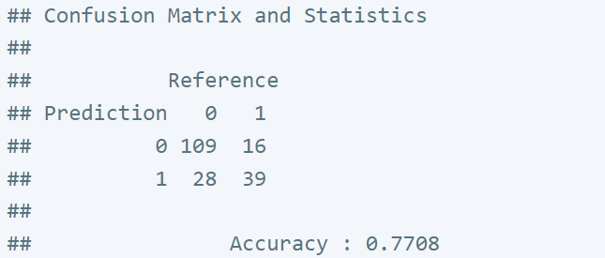
NAÏVE BAYES (0.77)
library(e1071)
model2 = naiveBayes(x = data_train[1:(length(data_train)-1)], y = data_train$Outcome)

Slide 18
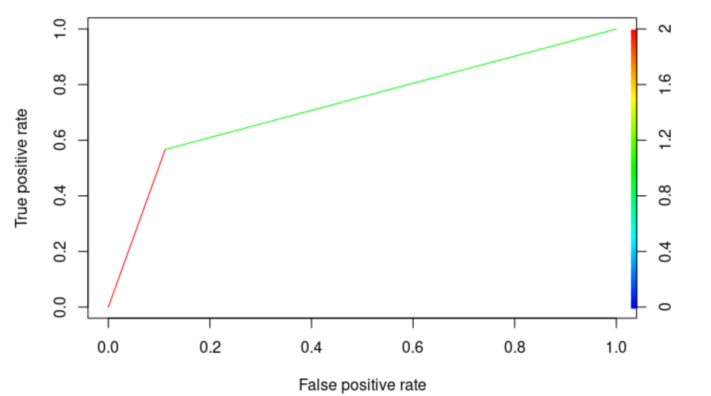
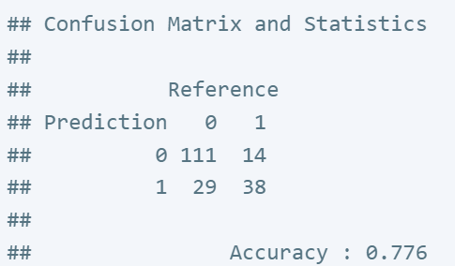
RANDOM FOREST (0.7706)
model3 = randomForest(x = data_train[1:(length(data_train)-1)], y = data_train$Outcome, ntree = 500)

Slide 19
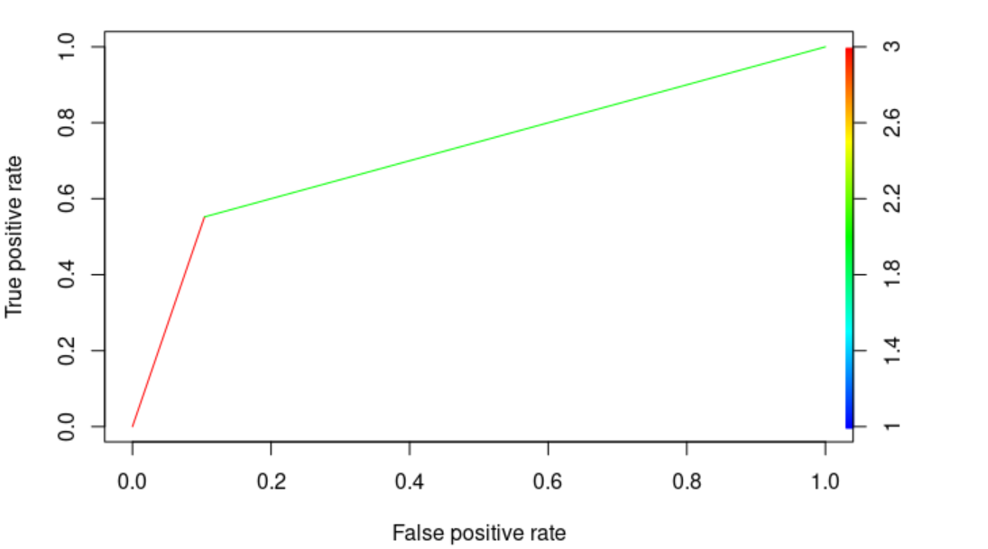
KERNEL SVM (0.7706)
model5 = svm(formula = Outcome ~ ., data = data_train, type = 'C-classification', kernel = 'radial') model5

Slide 20
DATA ANALYSIS USING R :
We have performed the Chi-square test in which the p-value for the Chi-square test indicates the likelihood of achieving a chi-square as large as or larger than that in the current experiment and the data still supporting the hypotheses. We have also run the Anova F test.
The Anova F test's F-value and P-value are inversely correlated, meaning that the greater the F-value, the lower the P-value. The F-values reveal that the average glucose level and age both have high F-values, which indicate less P-value, which in turn indicates a strong relationship between the variables and the risk of having a Diabetes.

Slide 21
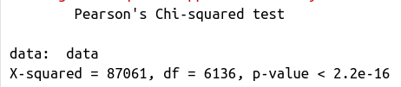
RESULTS FOR CHI-SQUARE TEST ANALYSIS:
In the Chi-square test, the p-value(p-value < 2.2e-16) denotes the probability of obtaining a chi-square as large or larger than that in the current experiment and yet the data will still support the hypotheses.
P value higher than 0.05 is not statistically significant and indicates strong evidence for the null hypothesis. Hence, we can conclude that the chi-square p values greater than 0.05 have little significance to the actual prediction.

Slide 22
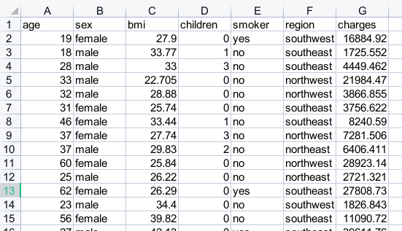
INSURANCE PREDICTION

Slide 23
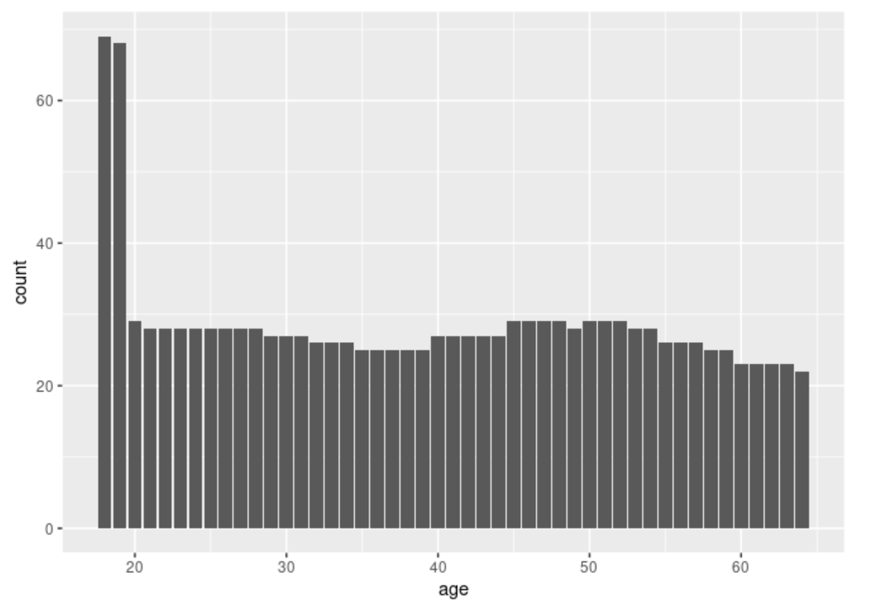
DATA ANALYSIS USING R :
library(ggplot2)
#Plotting the age of participants and their count with respective age.
ggplot(insuranceDataset, aes(age, fill = age ) ) + geom_bar()

Slide 24
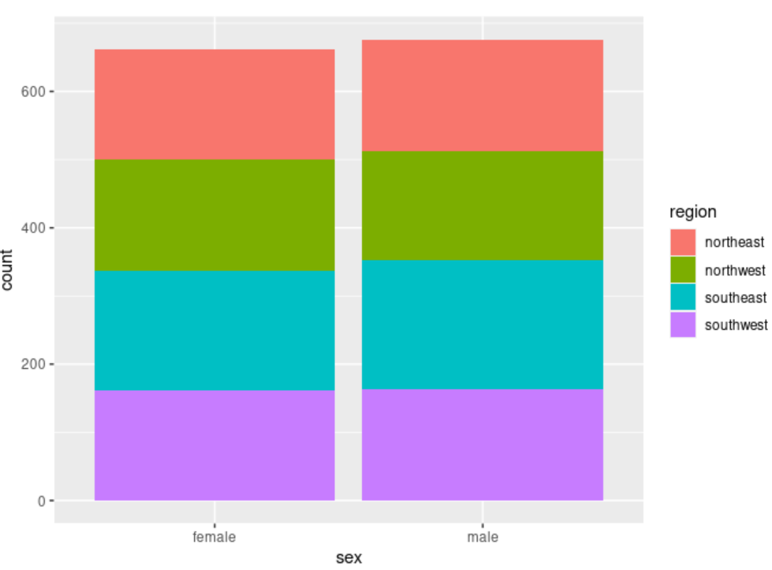
DATA ANALYSIS USING R :
ggplot(insuranceDataset, aes(sex, fill = region) )
+ geom_bar(position = "stack")

Slide 25
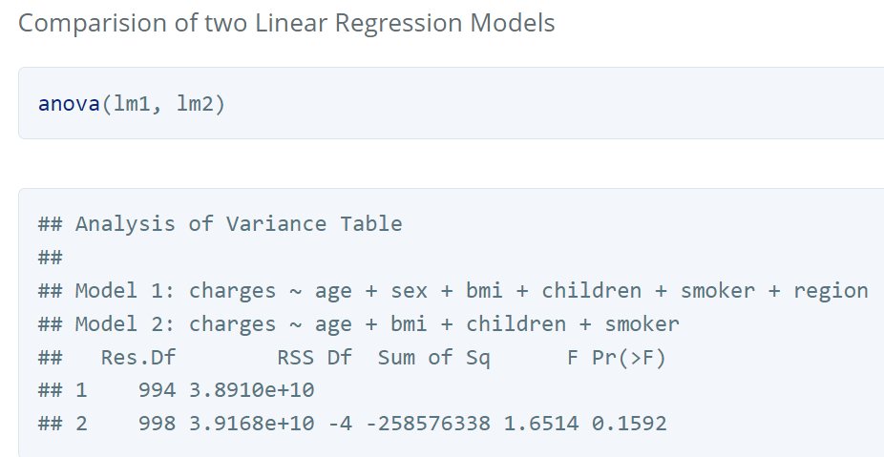
COMPARISION OF TWO LINEAR REGRESSION MODELS

Slide 26


FUTURE WORK FOR REVIEW-3:
We will link the analysis to a website interface which technical stack: HTML,CSS for frontend, & R for machine Learning and flask for backend.
User will be able to enter the details and get to know the possibility of Diabetes dynamically as well as get to know their estimated insurance cost.

Slide 27
THANK YOU !!!

